Slide 1


VISVESVARAYA TECHNOLOGICAL UNIVERSITY “JNANA SANGAMA”, BELAGAVI, KARNATAKA-590 018 MYSURU ROYAL INSTITUTE OF TECHNOLOGY Lakshmipura Road, Srirangapatna, Mandya – 571406 DEPARTMENT OF ELECTRONICS AND COMMUNICATION ENGINEERING Project Work [BEC786] Phase-II Presentation on Title: “Soldier Health Monitoring and Position Tracking System”
Presented By
CHETAN.S
DIKSHITHA.M
VIJAYALAKSHMI D N
MAHADEV PRASAD BK
[4MU22EC007] [4MU22EC011] [4MU22EC046]
[4MU23EC403]
Under Guidance of
Prof. Krishnaveni K
Assistant Professor
Dept. of ECE

Slide 2


Contents
Abstract
Introduction
Literature Survey
Problem Statement
Objectives
Methodology
Components
Result
Merits
Application
Conclusion
Reference

Slide 3
Abstract
The Soldier Health Monitoring and Position Tracking System is an IoT-based solution aimed at continuously monitoring soldiers’ vital health parameters and geographical location in real time.
Sensors attached to the soldier collect data such as heart rate, body temperature, and stress levels, which are processed by the ESP32 microcontroller.
GPS and GSM modules enable live tracking and data transmission to a remote control center, allowing immediate assistance when required.
The system provides instant alerts when abnormal readings are detected, improving response time and reducing enhances the safety, awareness, and coordination of defense operations through real-time intelligence. potential casualties

Slide 4
INTRODUCTION
The Soldier Health Monitoring and Position Tracking System is an advanced IoT-based solution designed to improve battlefield safety and operational awareness. Centered around the ESP32 microcontroller, this system integrates multiple sensors to:
Monitor vital health parameters (body temperature, heart rate, humidity).
Track real-time location via GPS.
Enable emergency communication through GSM.
Detect hazardous gases for environmental safety.
Display real-time data using OLED.
Send distress signals with an emergency push button.

Slide 5
Literature Survey
SL NO | Title | Author | Summary | Pro’s and Con’s
1 | Power Optimization in Wearable Military Devices (2021) | Brown, D. | Achieved 60% power consumption reduction through advanced power management techniques. The optimized system provided 72-hour continuous operation on a single battery charge while maintaining full functionality. | Pros: Useful for mathematical modeling and combinatorial analysis. Cons: Rapid growth leads to computational complexity, limited use, and overflow errors
2 | Adaptive Sensor Fusion for Environmental Monitoring (2021) | White, C. & Black, M. | Created adaptive algorithms that improved sensor accuracy by 35% through intelligent data fusion. The system effectively compensated for individual sensor limitations and environmental interference. | Pros: Highly accurate and data-driven approach. Cons: Complex, data-dependent, and less adaptable to new conditions.
3 | Human Activity Recognition for Soldier Monitoring (2022) | Miller, S. & Jones, R. | Achieved 96% accuracy in recognizing soldier activities and behaviours. The system effectively identified normal, distressed, and unconscious states, enabling appropriate response protocols. | Pros: Improves automation and decision-making accuracy. Cons: Risk of false results, data bias, and privacy issues.

Slide 6
SL NO | Title | Author | Summary | Pro’s and Con’s
4 | Machine Learning for Predictive Health Analytics (2023) | Wilson T. | Developed ML algorithms achieving 93% accuracy in predicting health emergencies 30 minutes before occurrence. The system successfully prevented 87% of potential medical crises through early intervention alerts. | Pros: Enables efficient and accurate automated analysis. Cons: Prone to false alarms, privacy risks, and data dependency.
5 | Integration Challenges in Multi-Sensor Military Systems (2024) | Cooper, D. & Reed, A | Identified and solved major integration challenges in complex sensor networks. The research provided frameworks for successful implementation of multi-sensor military monitoring systems. | Pros: Enhances performance and system integration. Cons: Expensive, complex, and vulnerable to security issues.

Slide 7
Problem Statement
Traditional systems focus on tactical communication, not individual health monitoring.
Medical emergencies (e.g., heat stroke, cardiac arrest) often go undetected in real time.
Manual health checks are infrequent and impractical during active combat.
Separate health and GPS systems create data silos, delaying medical response.
Lack of gas detection exposes soldiers to invisible environmental hazards.
No real-time psychological monitoring for stress, fatigue, or trauma.
Voice-based emergency communication is unreliable in critical situations.
Absence of centralized, secure data storage limits analysis and future improvements.

Slide 8

Objective
Objective
Develop an IoT-based monitoring system using ESP32 for real-time soldier health and .
environmental tracking.
Measure vital parameters such as body temperature and heart rate using DHT11 and
AD8232 sensors.
Track geographical position with GPS NEO-6M for enhanced situational awareness.
Detect hazardous gases and monitor environmental conditions to ensure soldier safety.
Enable emergency communication via GSM SIM800L with manual and automatic alert
mechanisms.
Integrate emotion recognition using facial detection to assess psychological well-being in
real time.

Slide 9
Methodology
Power supply
Buck converter
Heart rate sensor
Esp32
microcontroller
SIM MODULE
(GSM/4G)
Temperature sensor
Cloud storage
Command center monitoring
MQ Series gas sensor
GPS NEO 6M
Push button
OLED Display
AI/ML Processing
(Emotion detection)
Fig 1: Block diagram of Soldier Health Monitoring and Position Tracking System

Slide 10
This system is designed to monitor Soldier health and position tracking using various sensors and communication modules. The ESP32 microcontroller acts as the central processing unit that integrates all components.
1) ESP32 – Dev KitC
The ESP32 Dev Kit C collects sensor and GPS data, then wirelessly transmits a soldier’s health and location information in real time.
2) Pulse Sensor
The pulse sensor monitors a soldier's heart rate in real time to assess physical condition and detect signs of stress or fatigue.
3) Temperature sensor DHT11
The DHT11 sensor monitors a soldier's body temperature and ambient humidity to help assess health status and environmental conditions.
4) GPS Module NEO 6M
The NEO-6M GPS module delivers precise real-time location data for accurate soldier position tracking and navigation.
5)GSM SIM800L
The SIM800L GSM module enables wireless communication by sending health alerts and location data via calls, SMS, or GPRS in real time.

Slide 11
6) Push button
The momentary contact switch allows soldiers to manually trigger emergency alerts and transmit their location instantly for rapid assistance.
7) OLED Display
The OLED display provides real-time visual feedback of a soldier’s vital signs, location, and system status directly on the device
8) MQ Series Gas detector
Gas detector sensors monitor hazardous gas levels around soldiers to ensure safety by detecting toxic or combustible gases in real time.
9) Buck converter
The buck converter efficiently regulates and steps down battery voltage to power the soldier’s monitoring and tracking electronics reliably.
10) Connecting Wires/Breadboard/PCB
The breadboard power supply module provides stable 3.3V or 5V regulated power to the soldier’s health monitoring and tracking system components during development and testing.
11)Power Adaptor
The power adaptor converts AC mains power into stable low-voltage DC to reliably power the soldier’s health monitoring and tracking system.
12) Arduino IDE
The Arduino IDE is a beginner-friendly, open-source software used to write, compile, and upload code to Arduino boards across multiple platforms.

Slide 12
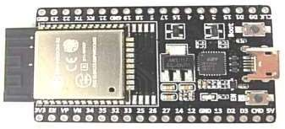
Hardware Components
1. ESP32 – Dev KitC
Description : The ESP32 Dev Kit C is a compact, dual-core microcontroller board with built-in Wi-Fi and Bluetooth, offering versatile GPIOs and integrated peripherals for IoT and embedded applications.
Specifications:
Dual-core 32-bit LX6 CPU (160-240 MHz).
4MB Flash, 520KB SRAM.
39 GPIO pins with ADC, DAC, PWM, touch, RTC.
Built-in Wi-Fi (2.4 GHz) and Bluetooth (BLE).
UART, SPI, I2C communication.
Powered via Micro-USB, 3.3V/5V outputs.
Fig 2: ESP32 Board

Slide 13
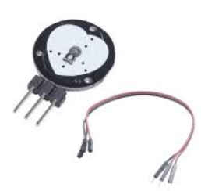
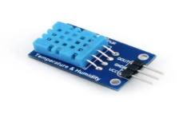
2.Pulse Sensor
Description : The pulse sensor uses PPG technology with a green LED and photodetector to monitor heart rate by
detecting blood volume changes in the skin.
Specifications:
Uses photoplethysmography (PPG) technology.
Bright green LED (around 520 nm wavelength).
Photodetector measures reflected/transmitted light.
Detects blood volume changes with each heartbeat.
Outputs a pulsatile waveform corresponding to cardiac cycles.
3.Temperature Sensor DHT11:
Description line:The DHT11 digitally measures temperature and humidity with simple, reliable output.
Specifications:
Temperature: 0–50°C, ±2°C accuracy.
Humidity: 20–90%, ±5% accuracy.
Digital output via single-wire interface.
Updates data every 2 seconds.
Uses capacitive humidity sensor and thermistor.
Fig 3: pulse sensor
Fig 4: temperature sensor

Slide 14
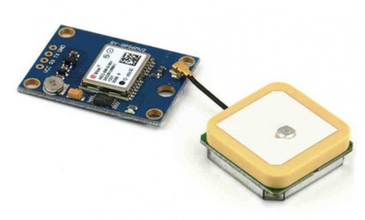
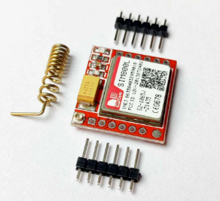
4.GPS Module NEO 6M
Description: NEO-6M is a GPS module that provides accurate real-time location data with low power use.
Specifications:
Accuracy: ±2.5 meters.
NMEA data format output.
Fast signal acquisition.
Low power operation.
UART communication.
5.GSM SIM800L
Description: SIM800L is a GSM/GPRS module that enables SMS, calling, and data transmission over mobile networks.
Specifications:
Quad-band: 850/900/1800/1900 MHz.
Supports SMS (text & PDU) and voice calls.
UART communication with AT commands.
Built-in TCP/IP stack for GPRS.
Wide temp range: -40°C to +85°C.
Fig 5: GPS Module NEO 6M
Fig 6: GSM SIM800L

Slide 15
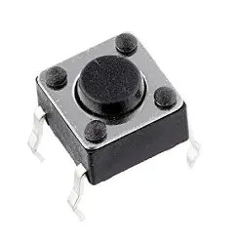
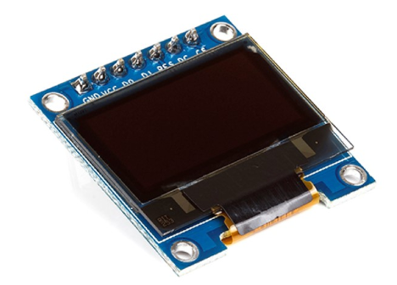
6. Push button
Description: Push button manually triggers emergency alerts.
Specifications:
Momentary, normally-open switch.
Connects via ESP32 GPIO.
Interrupt-based signal activation.
Tactile and glove-friendly operation.
7. OLED Display
Description:OLED displays real-time data visually.
Specifications:
Interface: I2C or SPI communication.
No backlight; uses self-lit pixels.
High contrast and low power usage.
Small, lightweight form factor.
Displays text, graphics, and sensor data.
Fig 7: Push Button
Fig 8: OLED Display

Slide 16
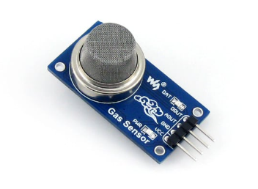
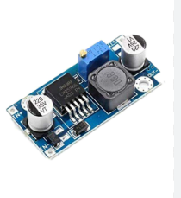
8. MQ Series Gas detector
Description: Detects various harmful gases in real-time using MOS technology with analog or digital output.
Specifications:
Operates at 5V DC with built-in heating element (200–300°C).
Detects gases like LPG, smoke, methane, CO, and hydrogen.
Provides analog output; some models also support digital output.
Detection range varies by model (e.g., MQ-2: 300–10,000 ppm).
Compact and easy to integrate into electronic systems.
9. Buck converter
Description: Steps down DC voltage efficiently using high-frequency switching. Specifications:
Converts high input voltage to lower regulated output.
Efficiency ranges from 80% to 95%.
Operates at 50 kHz to 2 MHz switching frequency.
Uses PWM and feedback for voltage control.
Contains MOSFET, inductor, diode, and capacitors.
Fig 9: Gas detector
Fig10: Buck Converter

Slide 17
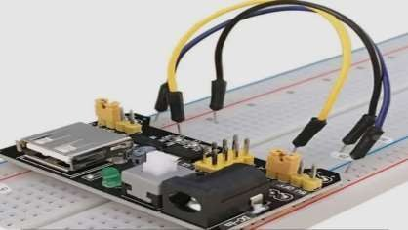
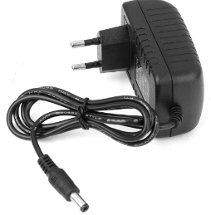
10) Connecting Wires/Breadboard/PCB
Description:
A compact module that provides regulated 5V or 3.3V power to breadboards or PCBs via USB or DC input.
Specifications:
Accepts DC input via barrel jack (5.5mm x 2.1mm) or USB.
Provides selectable 5V or 3.3V output using jumpers.
Includes on/off switch and power indicator LED.
Outputs voltage to both breadboard rails independently.
Output header pins for easy connection to breadboard or PCB.
11)Power Adaptor
Description:
A device that converts high-voltage AC to low-voltage DC for powering electronics.
Specifications:
Input: 110–240V AC.
Output: Regulated low-voltage DC.
Type: Switch-mode or linear.
Efficiency: 85–92% (switch-mode).
Compact and lightweight design.
Fig 11: Bread Board
Fig 12: Power Adaptor

Slide 18
Software Component
Arduino IDE
Description: An open-source software used to write, compile, and upload code to Arduino boards.
Specifications:
Supports Windows, macOS, and Linux platforms.
Compatible with multiple Arduino boards (Uno, Mega, etc.).
Built on Java with built-in libraries and functions.
User-friendly for beginners and non-programmers.
Enables code editing, debugging, and serial communication.

Slide 19
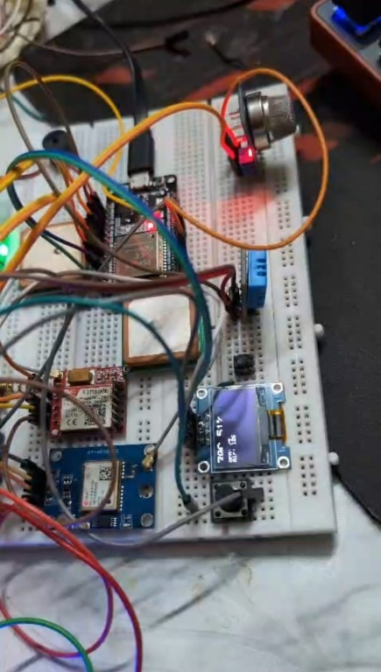
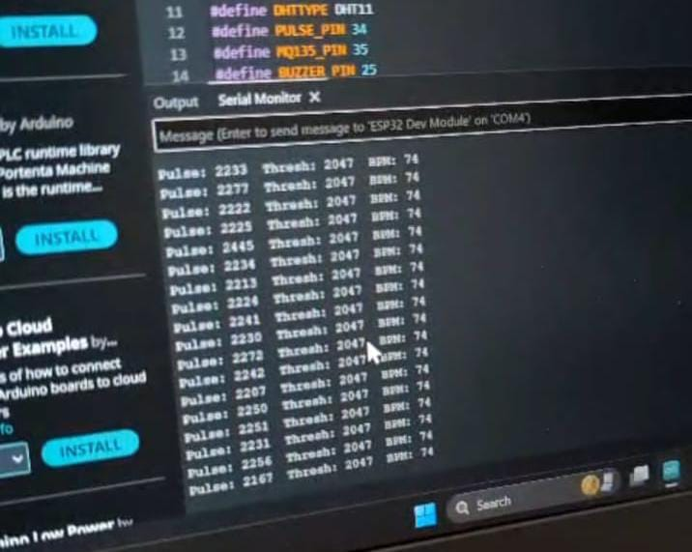
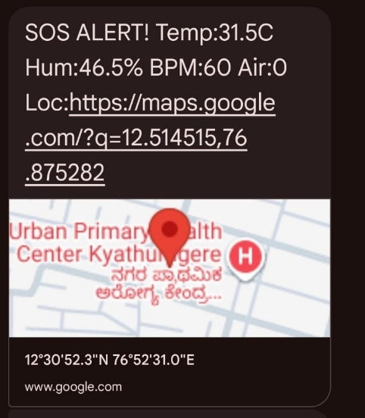
Result
Fig 13 :Circuit connection of components
Fig 14:Serial monitor
Fig 20:Cloud storage
Fig 21:SMS

Slide 20
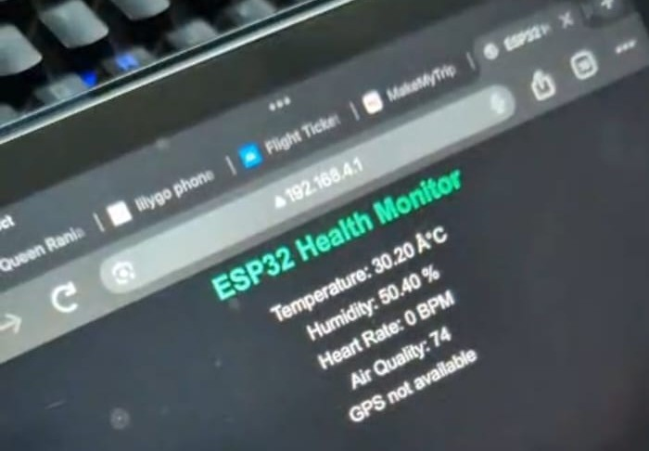
Fig 15 :Cloud storage
Fig 16 :SMS

Slide 21
Real-Time Health Monitoring.
Enhanced Situational Awareness.
Immediate Emergency Response.
Environmental Hazard Detection.
Psychological Wellness Monitoring.
Low Power Consumption.
Merits

Slide 22
Border Patrol and Surveillance.
Special Forces Operations.
Training and Simulation Exercises.
Chemical and Biological Warfare Environments.
High-Altitude Military Operations.
Desert Operations.
Disaster Relief Operations.
Application

Slide 23
Conclusion
The Soldier Health Monitoring and Position Tracking System effectively integrates real-time health monitoring, GPS tracking, and AI-based threat detection into a compact, reliable platform.
It meets military requirements for portability and performance, while also showing potential for civilian use in areas like emergency response and industrial safety.
Key technical achievements include sensor fusion, embedded AI deployment, and secure system integration.
The project proves that advanced monitoring capabilities can be miniaturized without compromising reliability, laying the groundwork for future autonomous and high-security monitoring systems.

Slide 24
References
Heart Beat Sensor Using Fingertip through Arduino P. Srinivasan 1, A. Ayub Khan 2, T. Prabu 3, M. Manoj 4, M. Ranjan 5, K. Karthik 6/ Journal of Critical Reviews (2020), ISSN- 2394-5125 Vol 7, Issue 7, P: 1058 - 1060.
R.S. Sabeenian, K.R. Kavitha “Long Term Monitoring of Sleep Disordered Breathing Using IOT Enabled Polymer Sensor Embedded Fabrics ”, International Journal of Psychosocial Rehabilitation, ISSN: 1475-7192, 24 & 7093 - 7010, May 16, 2020.
“Real-Time Tracking & Health Monitoring System of Remote Soldier Using Arm7 ” by P. S. Kurhe and S. S. Agrawal, which discusses the use of an Arm7 microcontroller to track the location and health of soldiers in real-time.
“Design and Development of GPS-GSM Based Tracking System with Google Map BasedMonitoring ” by Pankaj Verma and J.S Bhatia, which describes a tracking system that uses GPS and GSM technologies to monitor soldiers and display their location on a Google map.
“Implementation of GSM Based Heart Rate and Temperature Monitoring System ” by Subhani Sk. M. Sateesh G.N.V, Chaitanya Ch., and Prakash Babu G., which focuses on monitoring soldiers' heart rate and temperature using GSM technology.

Slide 25
THANK YOU

